Slide 1
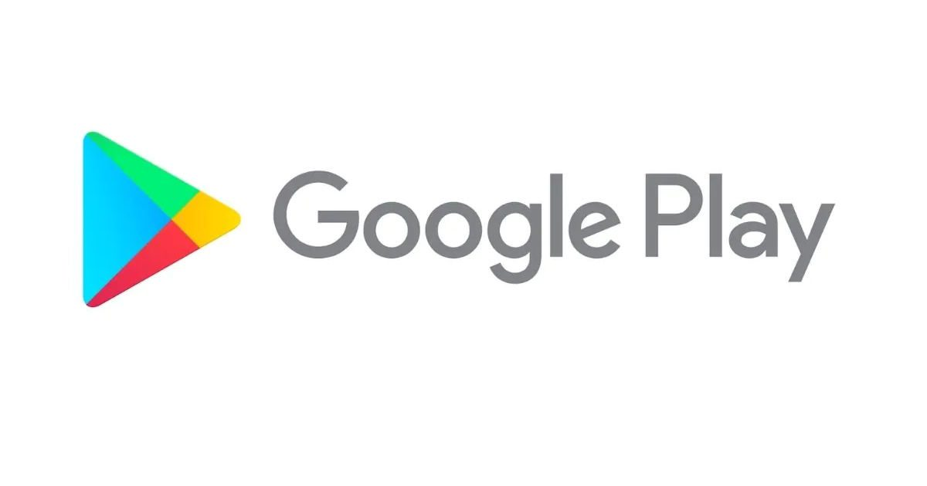
Capstone Project - 1
EDA ON GOOGLE PLAY STORE APP REVIEWS
Presentation by :
Amol Thakur
Data science trainee at AlmaBetter

Slide 2
Problem Statement
There is a vast amount of data in the Google Play Store app dataset that may be leveraged to produce insightful analysis. The success and user engagement are greatly influenced by a number of important aspects. When compared to the current Google Play store App market, our issue statement is almost inevitable. Following extensive study, it was discovered that the Google Play store library is growing rapidly every day. As a result, a range of insights may be drawn for business improvements.

Slide 3
Dataset description :
App :- Name of the App.
Category :- The classification that the App belongs in.
Rating :- App's rating on play store.
Reviews :- Number of reviews of the App.
Size :- Size of the App.
Install :- Number of Installs of the App.
Last Updated :- Date when the App was last updated.
Current Ver :- Current Version of the Application.
Android Ver :- Minimum Android Version required to run the App.
Type :- Whether the App is free or paid.
Price :- Price of the app.
Content Rating :- Audience that the app should be targeting.
Genres:- Genre under which the App falls.

Slide 4
Description of 2nd dataset
App : Name of the App.
Translated_Review : Opinions of people regarding a specific application
Sentiment : Weather the opinion/review of user is negative/positive/neutral
Sentiment_Polarity: Defines the orientation of the expressed sentiment(between -1(negative) to 1(positive) or 0(neutral))
Sentiment_Subjectivity : Refers to the degree to which a person's review is related to the App (lies between 0 to 1)

Slide 5
Importance of data analysis :
Data analysis is crucial since it aids companies in maximizing their performance. By finding more cost-effective ways to do business and retaining a lot of data, businesses may help cut expenses by incorporating it into their company strategy.
Data analysis is capable of much more than only identifying manufacturing flaws. The majority of players in a game are kept engaged by incentive schedules that gaming corporations create using data analytics. Many of the same data analytics are used by content providers to keep you clicking, viewing, or reorganizing material to obtain another look or click.

Slide 6
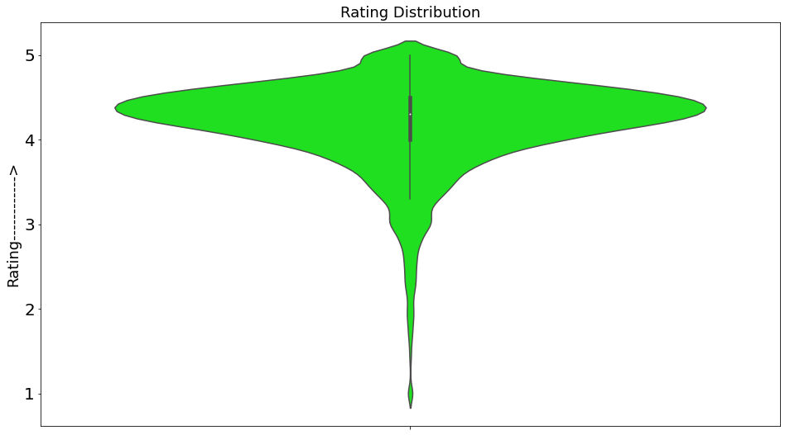
DATA VISUALIZATION
Here violin plot is used to study the distribution of ratings, from above plot we can conclude that most of the ratings ranges from 4.3 to 4.4 and that's where the median also lies, because of univariate analysis and to study the distribution we have used violin plot here.

Slide 7
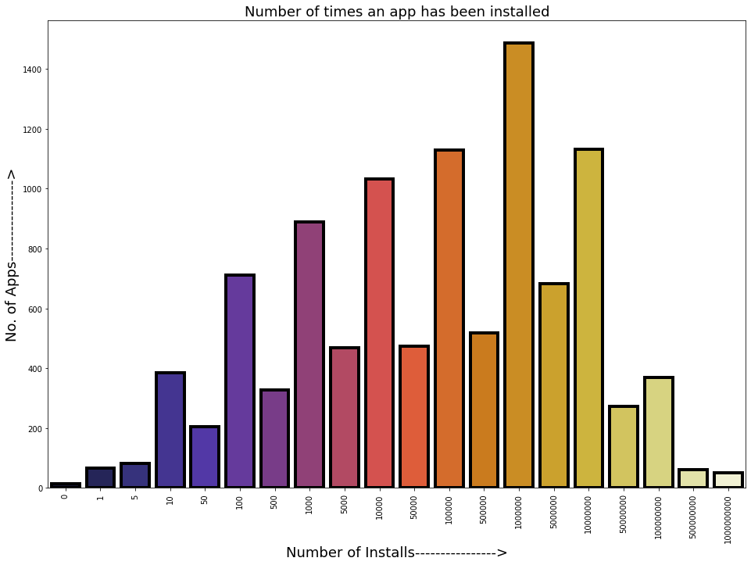
Here graph shows the number of apps on Y axis and the number of times those apps have been installed on X axis
The first major observation on y axis is 200 which is coinciding with the value 50 on x axis, this means that there are 200 apps which have been downloaded more than 50 times that are present in our dataset.
The highest value shows that there are near about 1500 apps that have been installed more than a million times
Notes:
Here it shows the number of apps on Y axis and the number of times those apps have been installed on X axis
The first major observation on y axis is 200 which is coinciding with the value 50 on x axis, this means that there are 200 apps which have been downloaded more than 50 times that are present in our dataset.
Method of analysis used here is also univariate.
The highest value shows that there are near about 1500 apps that have been installed more than a million times

Slide 8
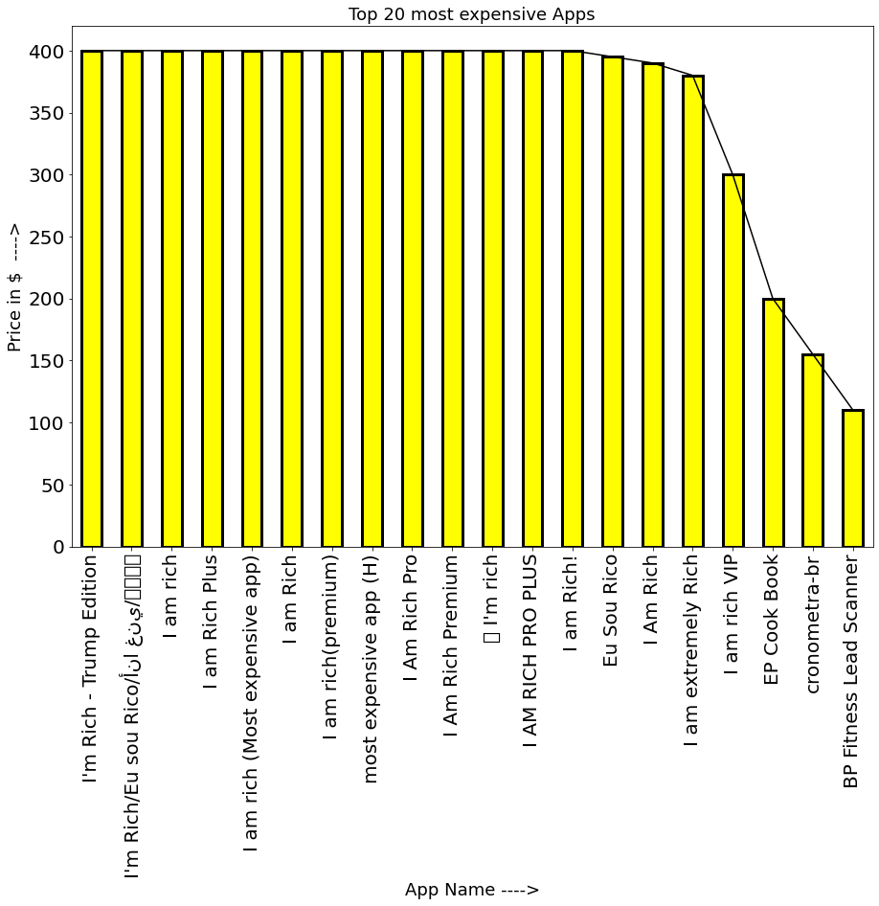
Here we can notice a trend that a large proportion of the top 20 most expensive apps have kind of similar names and price , that might be because of same functionality or origins.
Initially the graph is linear but at 14th observation it starts declining

Slide 9
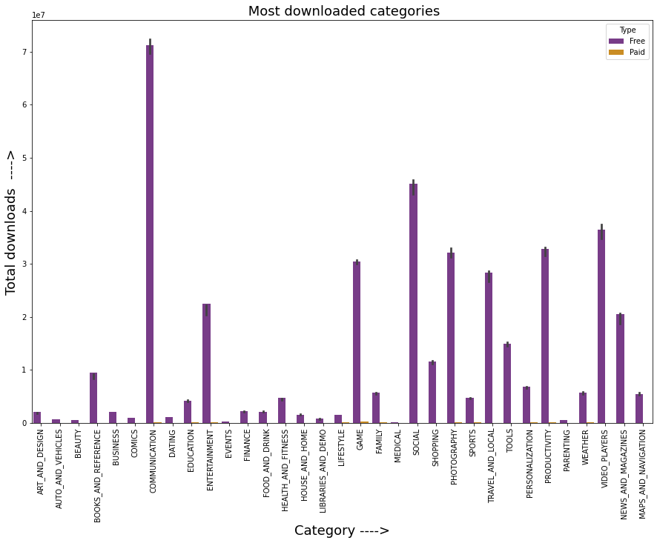
Here we can notice that the most downloaded category is COMMUNICATION as people love to communicate via video calls , texts and calls and the least downloaded category is MEDICAL.
Now let's find out what are the most downloaded apps that are present in COMMUNICATION category so we can have an idea why this category tops the charts

Slide 10
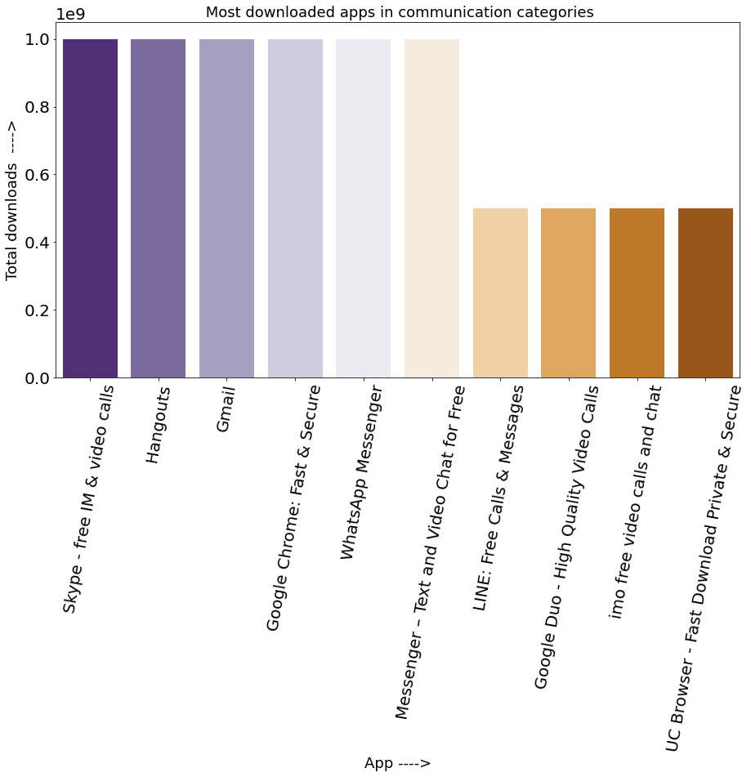
So here are the top 10 most downloaded apps in COMUNICATION category.
Most of the apps that are present in our Top 10 list comes pre installed in a lot of devices which might be the reason for these apps to have near about a billion installs.

Slide 11
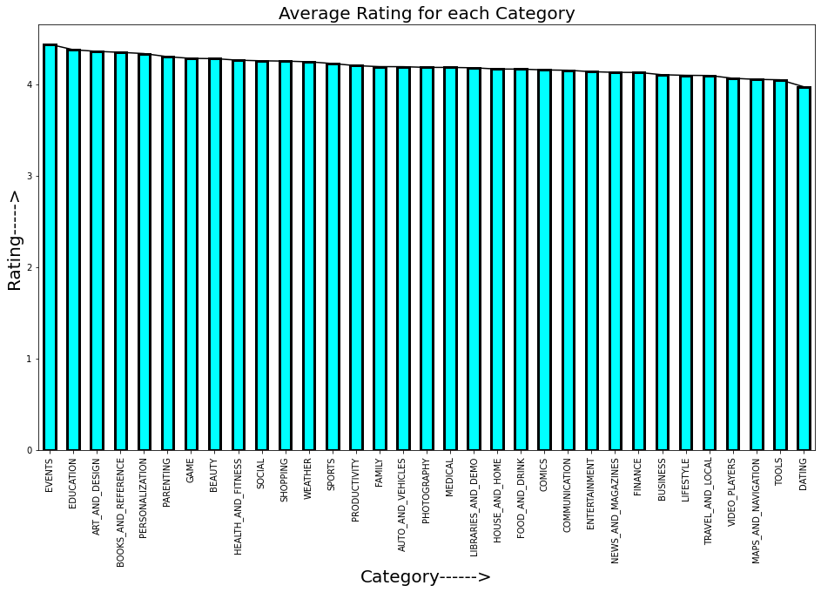
Even though COMMUNICATION is the most installed category but when it comes to ratings the stats says otherwise, the bar graph above clearly shows that the apps with category EVENTS tops the chart with highest average rating of 4.43 .
The lowest rated category is DATING with an average rating of 3.97

Slide 12
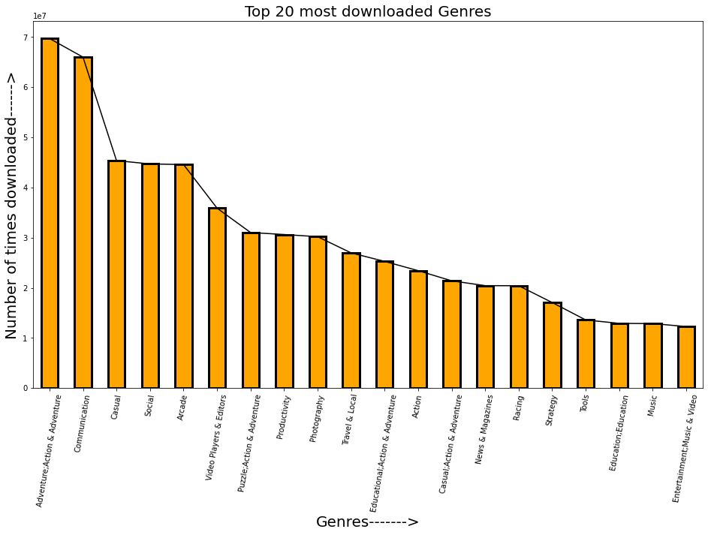
Bar plot above shows the most downloaded genres. It could be noticed that ,here the most downloaded genre is Adventure;Action & Adventure with more than 6.970385e+07 installs and unlike the bar graph which was plotted for categories in which COMMUNICATION topped the list here it is 2nd which is quite interesting .
This means that irrespective of some of the values being similar in both 'Category' and 'Genres' columns there's no actual relation between them and both are independent of each other.

Slide 13
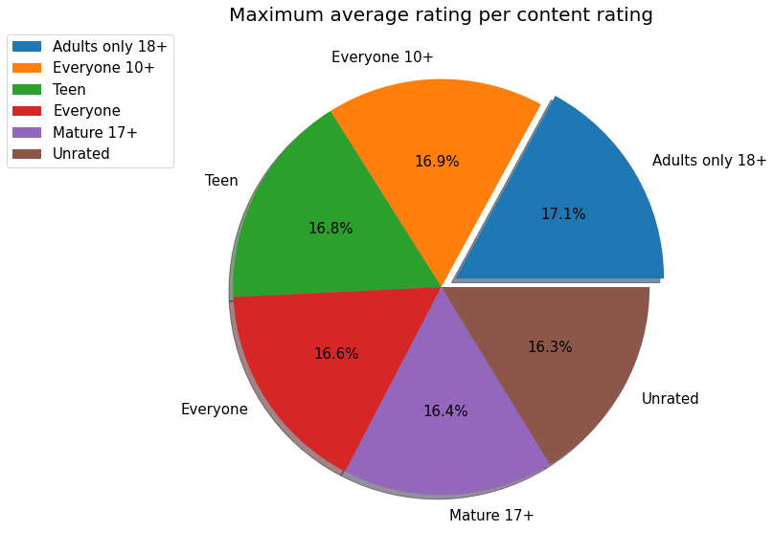
Above pie chart shows that content rating 'Adults only 18+' is highest rated among all other categories, but this does not mean that it is the most downloaded content rating, data analysis can be sometimes misguiding or tricky isn't it ?. So let's find out what's the most downloaded content rating is.

Slide 14
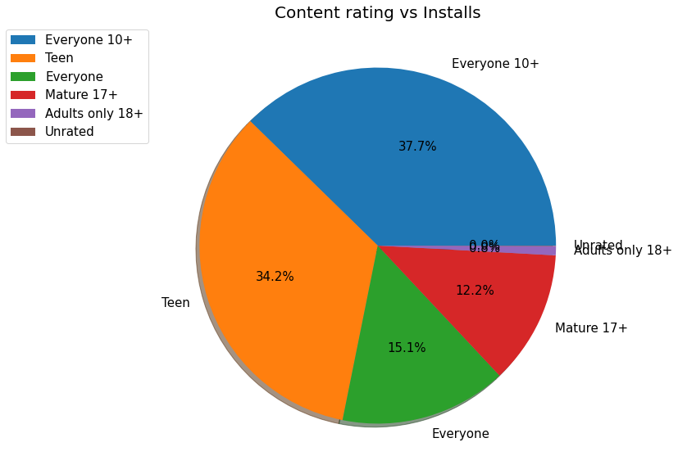
The above pie chart shows that the most downloaded content rating is "Everyone 10+ " as it acquires 37.7% of area in pie chart , it could be a very useful information for App Devs as they would focus more on building apps that falls in this content rating.
We can also notice that content ratings "Unrated" and "Adults only 18+" are the least downloaded categories , this is a bit surprising because of the fact that "Adults only 18+" was the highest rated content rating in our previous analysis yet it's not the most downloaded one and now it's clear that due to low number of installs the average ratings has spiked up .

Slide 15
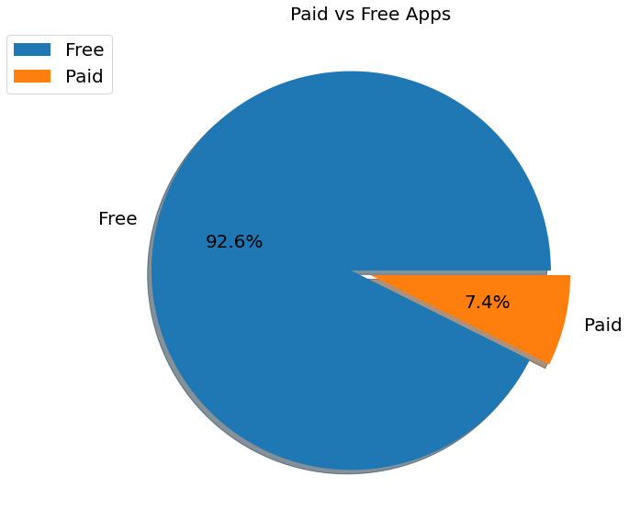
The vast majority of apps present on google play store are free as we can see from above pie chart ,Free apps(92.6%) are dominating Paid apps(7.4%) because users prefer apps that are free, it's quite understandable from here why devs focus more on building free apps rather than paid.

Slide 16
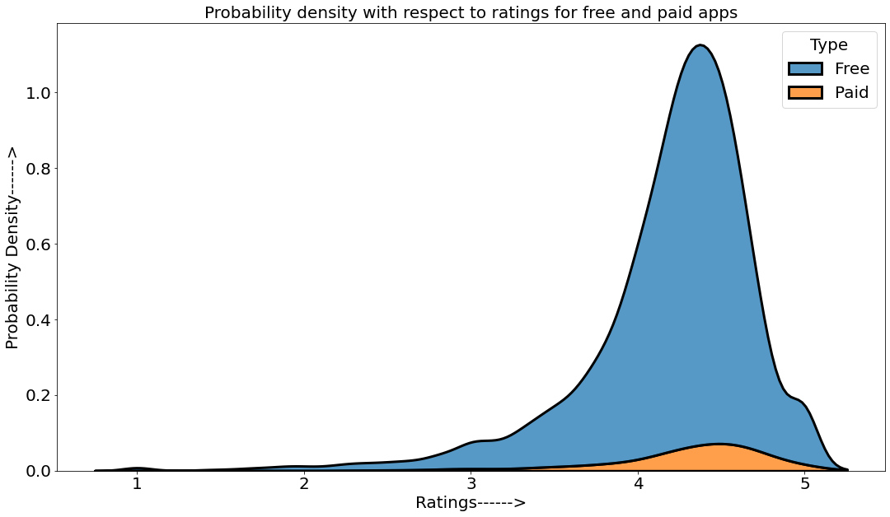
From the above kdeplot it's clear that the probability of an app being rated above 4 stars on play store is high if the app is free as users prefer free app against paid ones.
The probability density of a paid app being rated above 4 stars is extremely low as we can see in above kde plot, that might be because of lack of users using paid apps.
So app devs should focus more on making free apps or affordable paid apps so more users could download them.

Slide 17
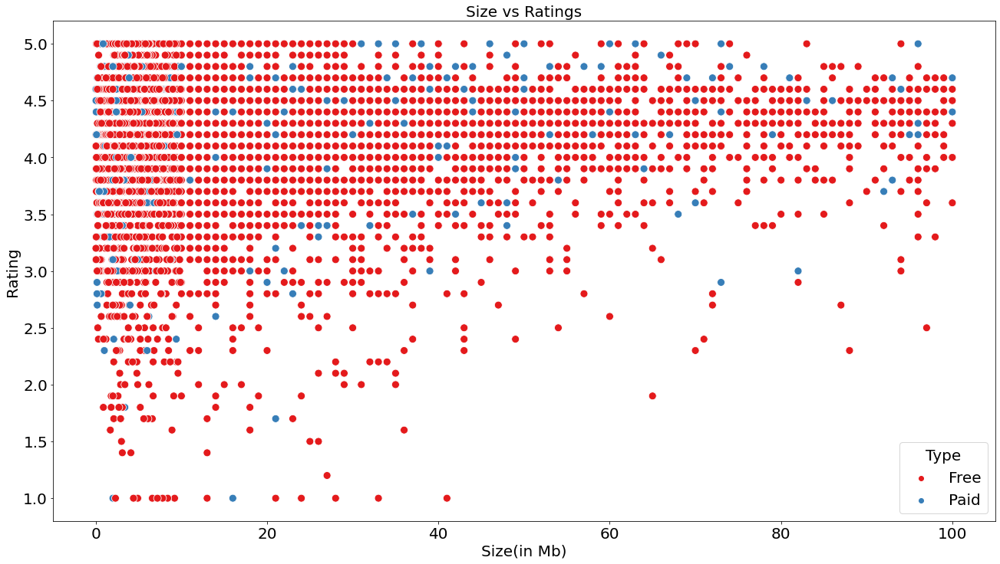
Above scatterplot shows the correlation between size and ratings and how these two affects each other.
As we notice when the size of an app increases the number of ratings or density of rating decreases that's because users avoid installing apps with big size and prefer using apps with smaller size to save data or storage on their phones.
After 40mb the rating density is decreasing which indicates in lack of users or lack of downloads/installs.
In case of paid apps the rating density is also slightly decreasing after 50mb which indicates that even paid users don't like apps that are big in size

Slide 18
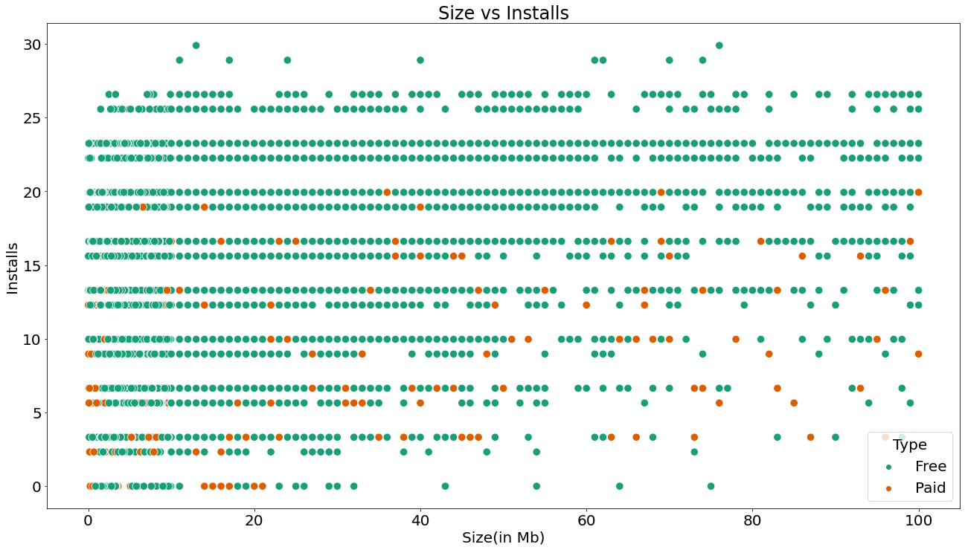
From the above scatterplot we can conclude that 'Installs' and 'Size' are inversely proportional to each other because as the size of app increases the number of installs decreases, we can clearly see that after size 40mb the density of Installs is decreasing in case of both free and paid apps. From 60mb to 100mb we can notice extremely low density of installs.
The most dense area of this scatterplot is between 0mb-10mb , this range of apps have the most chances of being installed.
So Devs should focus on building apps with smaller sizes.

Slide 19
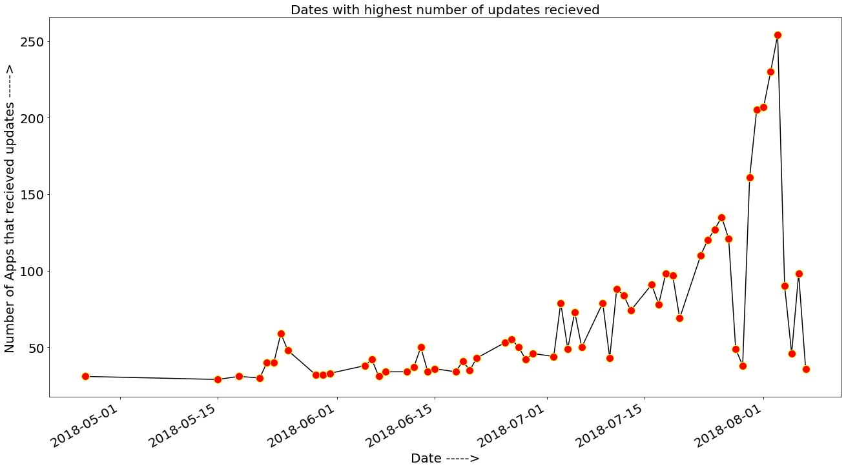
Line graph above shows the dates when apps on play store received the most amount of updates.
According to this line graph the most number of updates received on google play store was on date 2018-08-03 i.e 254 apps received updates on this day.

Slide 20
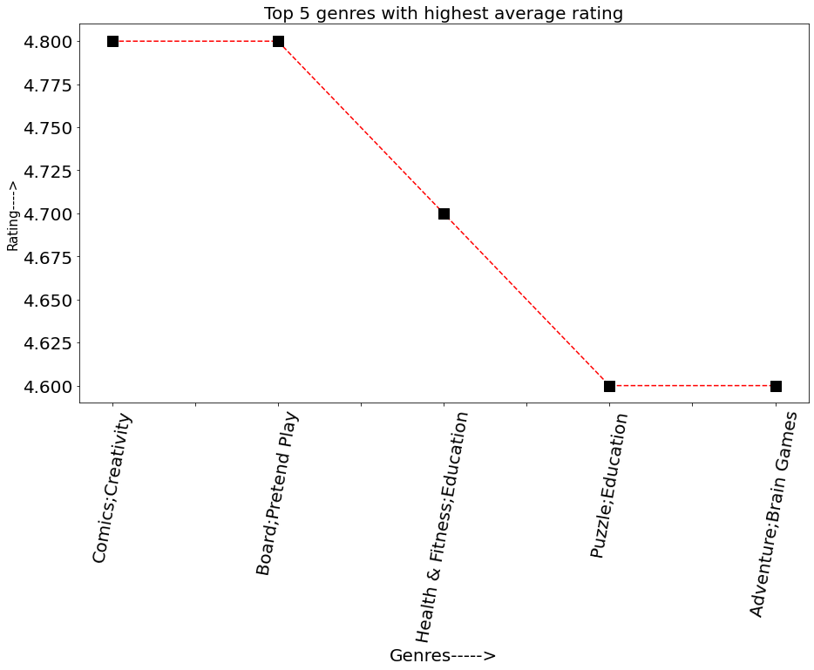
Here are the genres with highest average ratings where Comics;Creativity tops the chart

Slide 21
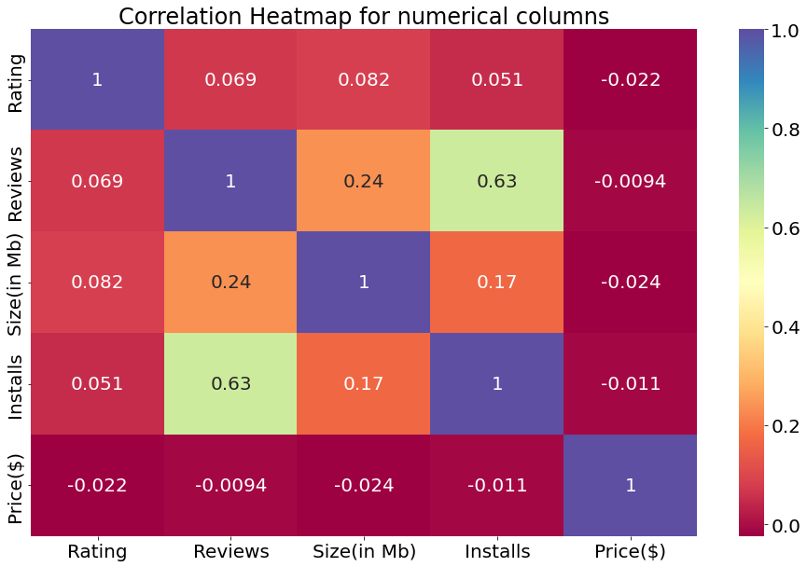
From the above heatmap we can conclude that 'Installs' and 'Reviews' share a strong correlation of 0.63 which means that they are directly proportional to each other, in general if the number of reviews will increase then the number of installs will also increase and vice-versa.
Price($) column has negative correlation with every column , that's because if price of an app increases then the number of installs will decrease which will further affect ratings and reviews, that's why most of the users prefer using free apps instead of paid ones.
In case of Ratings and Reviews they share positive correlation with every column (except Price($)), this is because if ratings and reviews will increase then there will be more probability of users installing a certain app.
The correlation between Reviews and Size(in Mb) is also positive (0.24), this might be because more number of reviews helps devs in understanding the actual needs of users which results in an app receiving more updates and features which further increases size of that app.

Slide 22
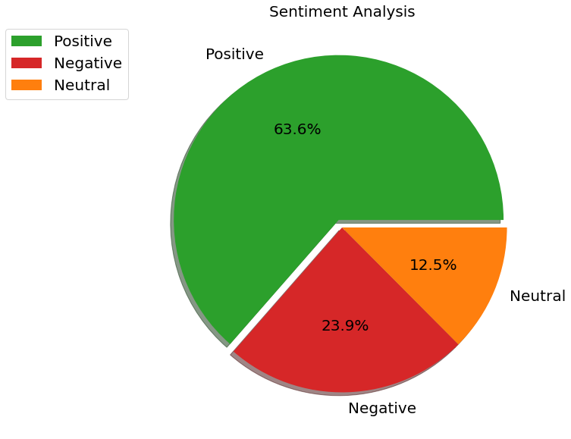
As expected the most number of sentiments are Positive(63.6%) followed by Negative(23.9%) and neutral(12.5%).
This is a good thing for devs as most of the users are satisfied by the services offered by apps.

Slide 23
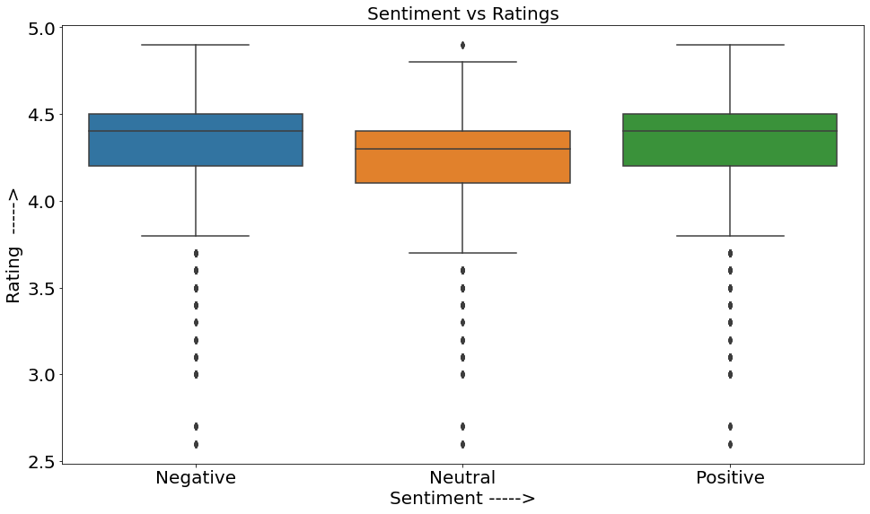
It's kind of unusual that median rating for Negative sentiments(4.4) is higher than median rating for Neutral sentiments(4.3) and is equal to Positive sentiments(4.4). This might be due to the fact that when a user installed an app he initially liked it and gave it more than 4 stars and a positive review but after the next update he/she disliked it because of some reasons and decided to update their review but might have forgot to update the rating that they gave the app initially.
The 2nd reason might be due an inconsistency/error in our data or during data collection.
This could also be true that there might some ratings that were generated by bots.

Slide 24
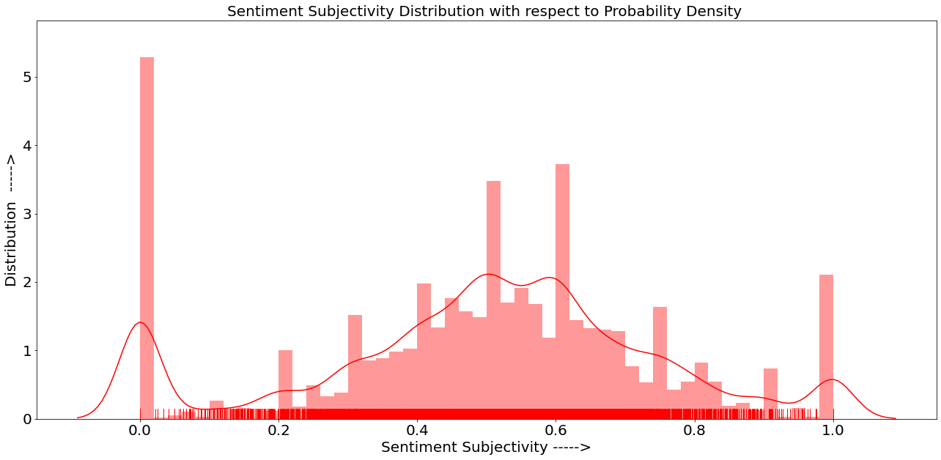
The dist plot here show some interesting and unusual trends. The most common sentiment subjectivity score is 0.0 as it has the highest number of counts ,but the kdeplot shows that even though 0.0 is the most common value, the probability of sentiment subjectivity being between 0.4 to 0.7 is much higher than the probability of it being 0.0 due to combined counts of values present between 0.4-0.7 .

Slide 25
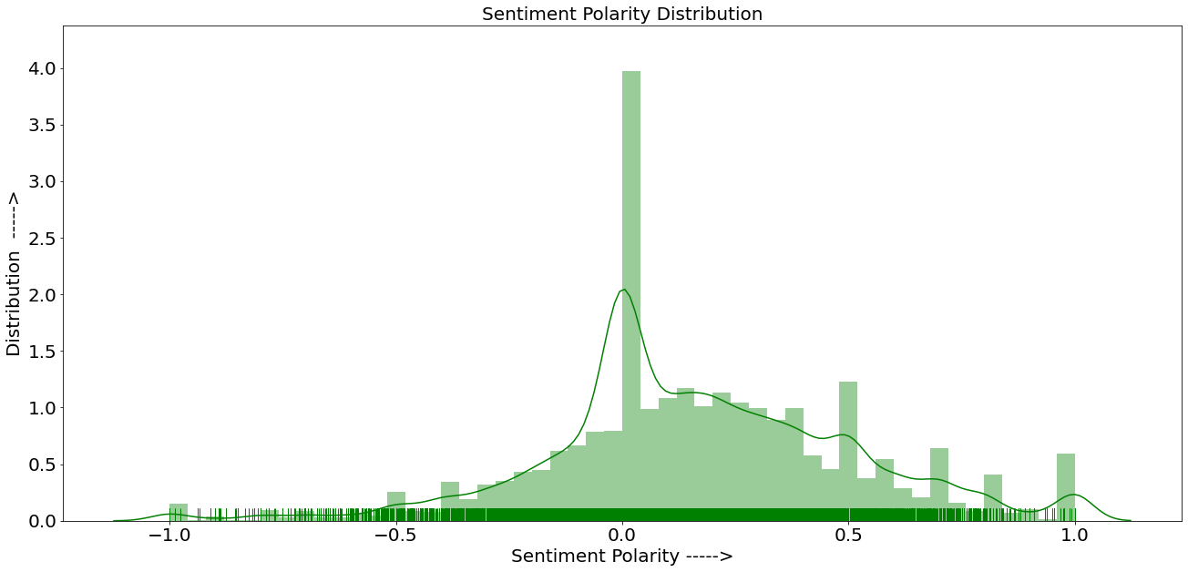
From the above plot we can see that most of the user reviews have a neutral sentiment polarity and the probability of sentiment polarity being 0.0 is the highest which means for any new review the possibility of it being neutral is the highest.

Slide 26
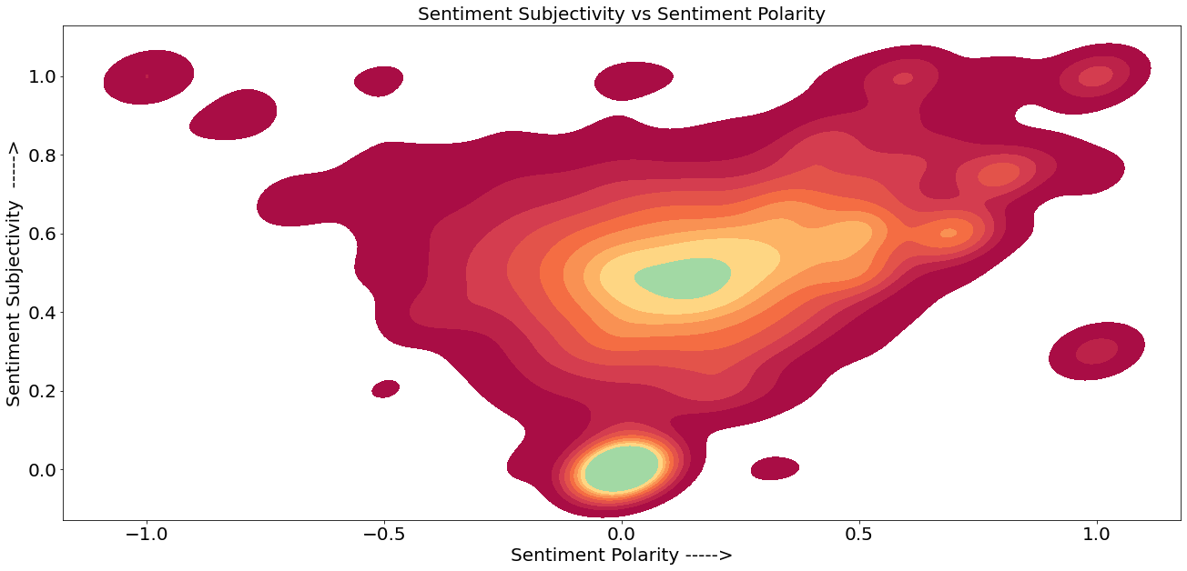
Kde plot shows that the probability of user reviews having sentiment polarity greater than 0.0 and sentiment subjectivity being between 0.2 - 1.0 is highest because most of the values lies between Sentiment Polarity(0.0-1.0) and sentiment subjectivity(0.2-1.0), which means that most of the reviews would be positive and slightly or heavily related to the app
We can also see that as the sentiment polarity is increasing towards the positive side the sentiment subjectivity is also increasing which means that the reviews are positive and related to apps. This is a good thing for devs as higher sentiment subjectivity gives them a more brief understanding about the problem users are facing and positive sentiment polarity motivates them to keep on working.

Slide 27
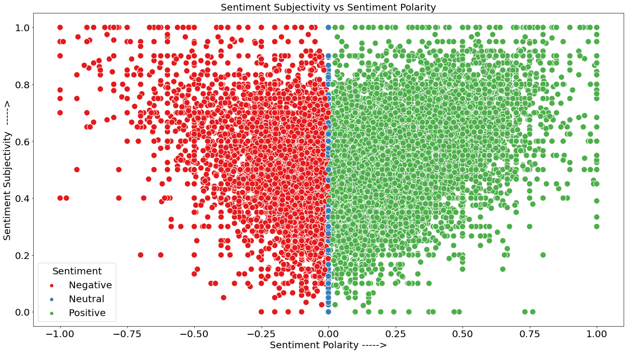
After analyzing the above distribution we can see that most of the sentiments are positive and highly subjective to the app. The sentiment polarity is highest between 0.0-0.75 while subjectivity is highest between 0.2 - 0.8 , meanwhile reviews with extremely positive polarity(1.0) and extreme high subjectivity(1.0) or extreme low polarity (-1.0) and extreme low subjectivity (0.0) have low density, which means that there's lack of extremely relevant and extremely irrelevant reviews.

Slide 28
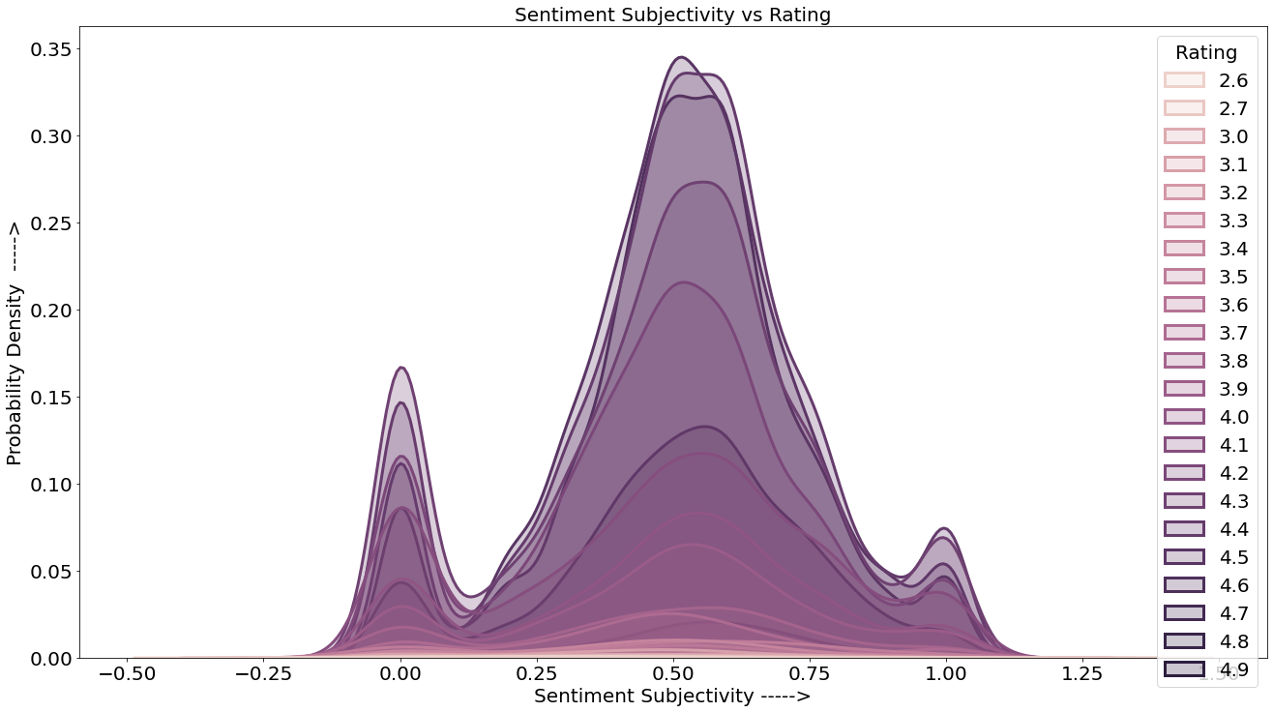
The probability of sentiment subjectivity being 0.50 and having rating more than 4 stars is the highest , which means that users whose reviews are moderately subjective to the apps have higher tendency to rate apps more than 4 stars.

Slide 29
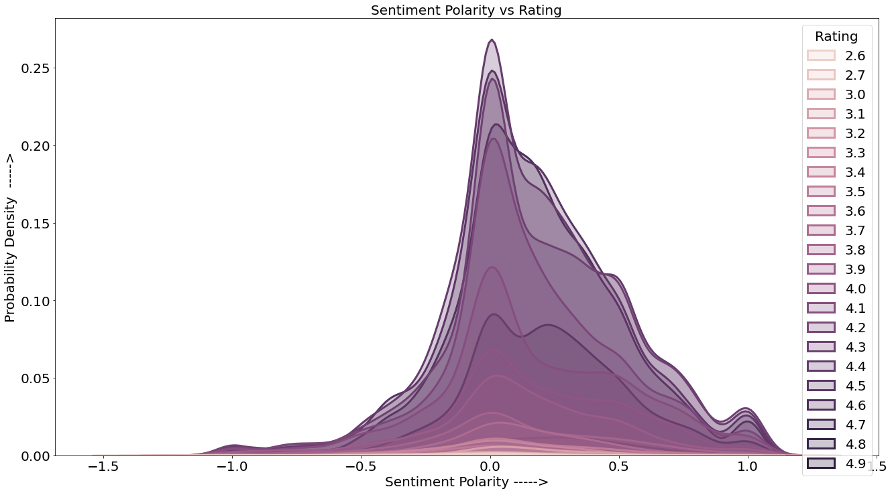
This graph almost tells us the same thing i.e the tendency of users to rate an app above 4 stars is highest when the sentiment polarity is neutral(0.0) .

Slide 30
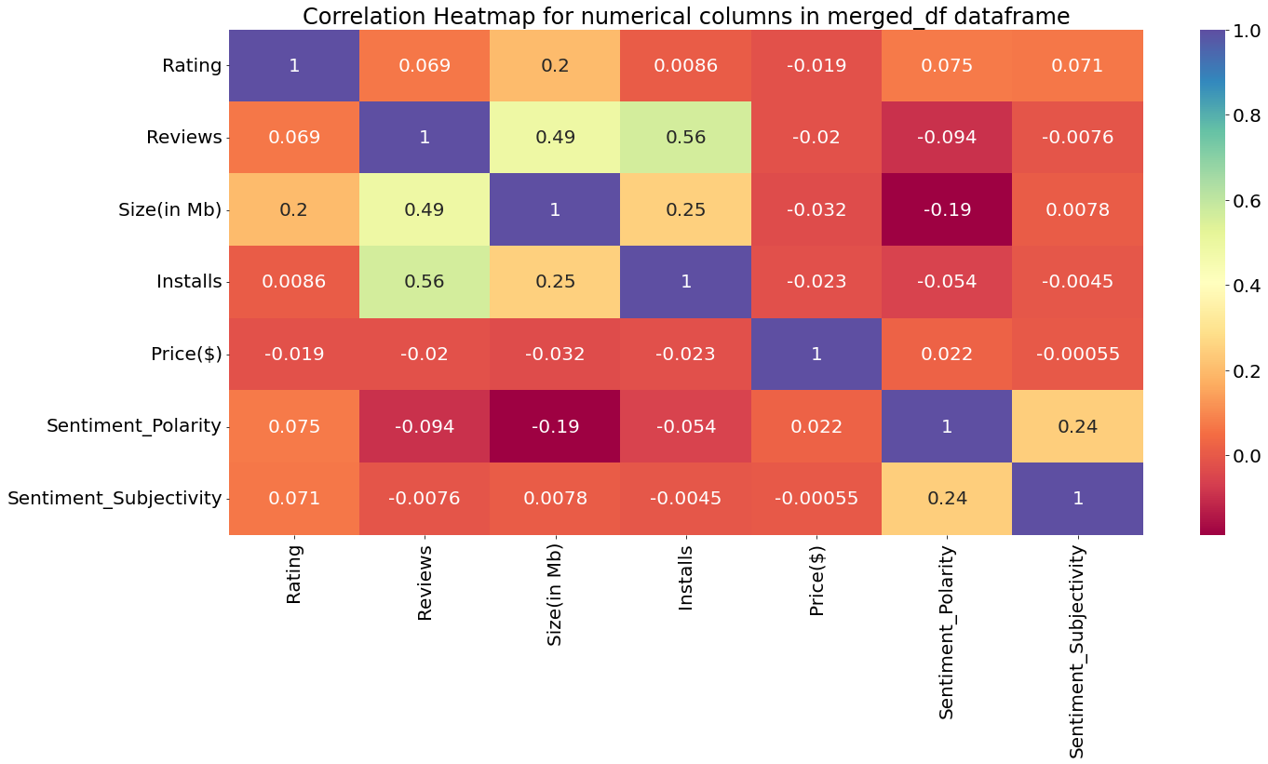
Here we can see the sentiment polarity and sentiment subjectivity are highly related to each other, and are directly proportional to each other this verify the fact that all the above graphs that we plotted to depict the relation between both these variables were correct.
Notes:
Here we can see the sentiment polarity and sentiment subjectivity are highly related to each other, and are directly proportional to each other this verify the fact that all the above graphs that we plotted to depict the relation between both these variables were correct.

Slide 31
Insights/Summary
Most common rating is 4.3 .
There are 1500 apps that have been downloaded over a million times.
The top most expensive apps have similar names and features and are almost of same price.
COMMUNICATION is the most downloaded category.
Skype , Hangouts , Gmail are the most downloaded apps in COMMUNICATION category.
EVENTS is the highest rated category
Adventure ; Action & Adventure is the most downloaded genre.
Everyone 10+ is the most downloaded Content Rating.
The most common sentiment subjectivity score is 0.0.
92.6% of apps are free and 7.4% are paid.
Probability of an app being rated more than 4 stars is high if it’s a free app as compared to a paid app.
As the size of an app increases the number of downloads decreases and rating density also decreases.
2018-08-03 was the date on which most number of updates were received by apps on play store.
Comics ; Creativity is the highest rated genre.
Reviews and Installs are highly correlated and so does size and installs.
Most number of sentiments are Positive(63.6%) followed by Negative(23.9%) and neutral(12.5%).
Rating is highest at 0.50 sentiment subjectivity and 0.0 sentiment polarity.
Sentiment polarity and Sentiment subjectivity are highly correlated and are dependent on each other.

Slide 32
1. Reading and handling large set of data.
2. Cleaning data for analysis.
3.Changing datatypes.
4.Generating insights.
5.Performing data visualization.
6.Explaining visualizations.

Slide 33
Conclusion
After analyzing the data, I was able to determine the answers to a number of significant and interesting questions that any android user would find fascinating. I carried out numerous operations to obtain insights such as rating distribution, the top 20 most expensive apps, the most downloaded categories according to their type, the top 10 most installed apps in the COMMUNICATION category, and many more. Overall, learning about the app industry was enjoyable and greatly aided my understanding of this domain.

